Slide 1
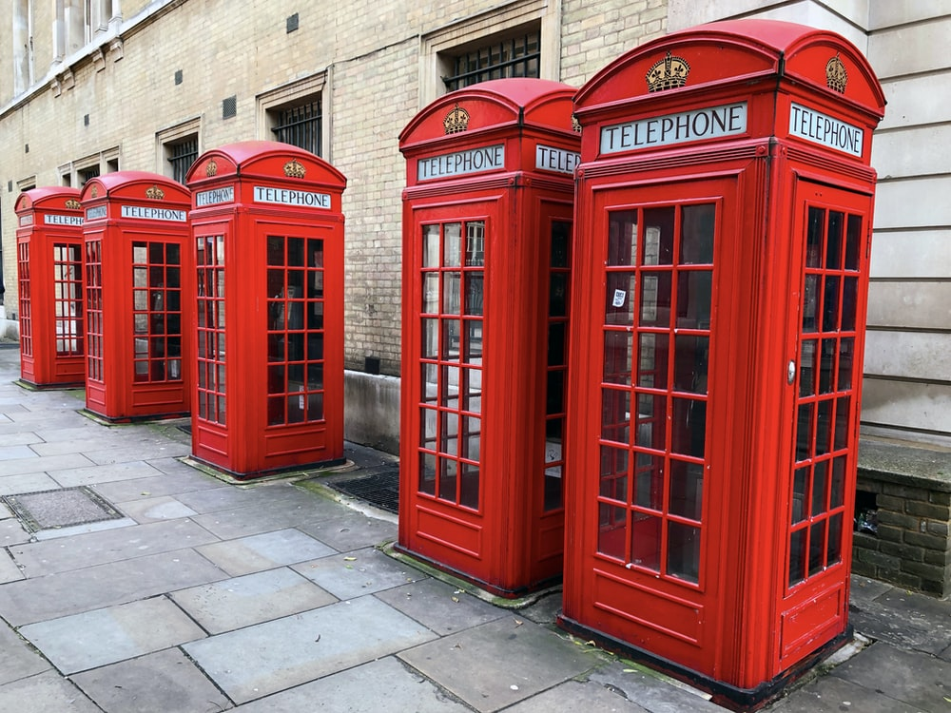
Prediction of Customer Attrition in the Telecom Industry using Machine Learning

Slide 2
Agenda
Introduction
Literature Review
Aim and Objective
Research Methodology
Results and Discussions
Conclusions and Future Recommendations

Slide 3
Introduction
Acquiring new customers is 5-10 times more expensive than keeping existing customers loyal.

Slide 4
Literature Review

Slide 5
Aim and Objective
Aim
The aim of the paper is to develop a trustworthy and interpretable model that will predict customers that will churn.
Objectives
Visualize patterns of customer behavior
Feature Selection to identify important attributes
Implement class balancing techniques to improve model performance
Develop and evaluate various machine learning models
To help the business make sense of the data and predictions, leverage interpretable machine learning

Slide 6
Research Methodology

Slide 7
Results and Discussions

Slide 8
Conclusions and Future Recommendations

